Slide 1
ATTITUDE MEASUREMENT AND SCALING
Presentation by:
Dr. Deepali Ubale

Slide 2
Meaning of Measurement and Scaling
Measurement: The term ‘measurement’ means assigning numbers or some other symbols to the characteristics of certain objects. When numbers are used, the researcher must have a rule for assigning a number to an observation in a way that provides an accurate description.
Definition: “When you measure what you are speaking about and express it in numbers, you know something about it, but when you cannot (or do not) measure it, when you cannot express it in numbers, then your knowledge is of a meager and unsatisfactory kind”.

Slide 3
“Measurement is the assignment of numerals to objects or events according to rules”.
Measurement is the assignment of numbers to represent properties”.
Scaling: Scaling is an extension of measurement. Scaling involves creating a continuum on which measurements on objects are located.

Slide 4
Nominal scale
This is the lowest level of measurement. Here, numbers are assigned for the purpose of identification of the objects. Any object which is assigned a higher number is in no way superior to the one which is assigned a lower number.
Example: Are you married? (a) Yes (b) No
Married person may be assigned a no. 1.
Unmarried person may be assigned a no. 2.
The assigned numbers cannot be added, subtracted, multiplied or divided. The only arithmetic operations that can be carried out are the count of each category. Therefore, a frequency distribution table can be prepared for the nominal scale variables and mode of the distribution can be worked out.

Slide 5
Ordinal scale
This is the next higher level of measurement. One of the limitations of the nominal scale measurements is that we cannot say whether the assigned number to an object is higher or lower than the one assigned to another option. The ordinal scale measurement takes care of this limitation. An ordinal scale measurement tells whether an object has more or less of characteristics than some other objects.
-Gives superior inferior relation- X, XII, graduation, PG

Slide 6
Numerals, letters, or other symbols are used to rank objects.
Categories have some explicit relationship among them.
Example: Taller shorter, greater lesser, faster slower etc.
Ordinal measurement do not provide on information on how much more or less of the characteristics various objects possess.
Example: If there are four different types of cement and if they are ordered on the basis of quality as Grade A, Grade B, Grade C, Grade D-then again it is an ordinal scale.

Slide 7
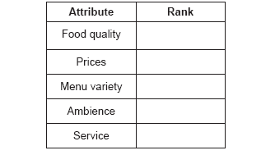
Types of Measurement Scale
Example: Rank the following attributes while choosing a restaurant for dinner. The most important attribute may be ranked one, the next important may be assigned a rank of 2 and so on.
In the ordinal scale, the assigned ranks cannot be added, multiplied, subtracted or
divided. One can compute median, percentiles and quartiles of the distribution. The other major statistical analysis which can be carried out is the rank order correlation coefficient, sign test.

Slide 8
Interval scale
The interval scale measurement is the next higher level of measurement.
It takes care of the limitation of the ordinal scale measurement where the difference between the score on the ordinal scale does not have any meaningful interpretation.
It is assumed that the respondent is able to answer the questions on a continuum scale.

Slide 9
The mathematical form of the data on the interval scale may be written as
Y = a + b X where a ≠ 0
Ratio of the score on this scale does not have a meaningful interpretation.

Slide 10

Example:
The numbers on this scale can be added, subtracted, multiplied or divided. One can compute arithmetic mean, standard deviation, correlation coefficient and conduct a t-test, Z-test, regression analysis and factor analysis.

Slide 11
Ratio scale
This is the highest level of measurement and takes care of the limitations of the interval scale measurement, where the ratio of the measurements on the scale does not have a meaningful interpretation.
The mathematical form of the ratio scale data is given by Y = b X.
In ratio scale, there is a natural zero (origin).
Example: How many chemist shops are there in your locality?
How many students are there in the MBA programme at IIFT?
All mathematical and statistical operations can be carried out using the ratio scale data.

Slide 12
Classification of Scales
Single item vs multiple item scale
In the single item scale, there is only one item to measure a given construct.
In multiple item scale, there are many items that play a role in forming the underlying construct that the researcher is trying to measure. This is because each of the item forms some part of the construct which the researcher is trying to measure.

Slide 13
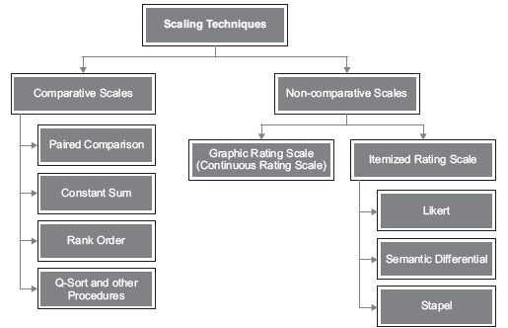
Classification of Scales
Comparative vs non-comparative scales

Slide 14
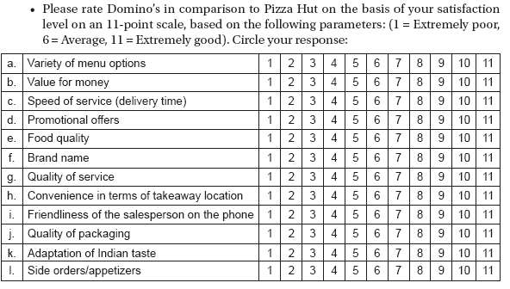
Classification of Scales
Comparative scales – In comparative scales it is assumed that respondents make use of a standard frame of reference before answering the question.
Example:

Slide 15
Formats of Comparative Scales
Paired comparison scales : Ex. Dominos & Pizza hut
Rank order scale: ex. Ranking of television serial from 1 to 10 scale
Constant sum rating scale:

Slide 16
Constant sum rating scale
Constant sum scales are a less frequently used question in surveys when compared to basic Likert scales, or checklists (i.e. multiple response options). They are an excellent way to create variance among a data set and truly understand which factors are key and which are not for customers or respondents.
They are especially helpful if you need to ask a question to a customer or respondent where you believe several factors are critical or of high importance. You are more likely to create differentiation in the data with a constant sum when compared to other question types.

Slide 17
Example of a Single Response Question
Let's say you want to understand what factor(s) matter most to a consumer when purchasing a home. There are several ways you can ask this.
One option is a single response question:
Q: What one factor is most important to you when buying a home? Select one.
A: Price, Location, School District, Inside Features, etc.

Slide 18
You are likely to get a mix of different responses here and your results may look like: price (40%), location (25%), school district (10%), inside features, (5%), etc. However, you do lack some context as to exactly how much more important price is compared to others. For some price may be very important but for others, it is not. However, a single response is likely to create more differentiation than a multiple response or likert scale option.
But there is always a risk that each option comes back with an equal share within the margin of error. The results may appear as price (20%), location (20%), school district (20%), inside features (20%), etc. It is near impossible for anyone to understand which of these choices may be more or less important than the other.

Slide 19
Example of a Multiple Response Option
Q: What factor(s) are most important to you when buying a home? Select all that apply.
A: Price, Location, School District, Inside Features, etc.
Here, if all of the categories are deemed very important by the respondent you may end up with response breakdowns like price (96%), location (93%), school district (85%), inside features (83%), etc. This creates even less variance among responses making it more difficult to differentiate.
Similar to the single response question, this also runs the risk of diluting the analysis by respondents seemingly selecting everything as important.

Slide 20
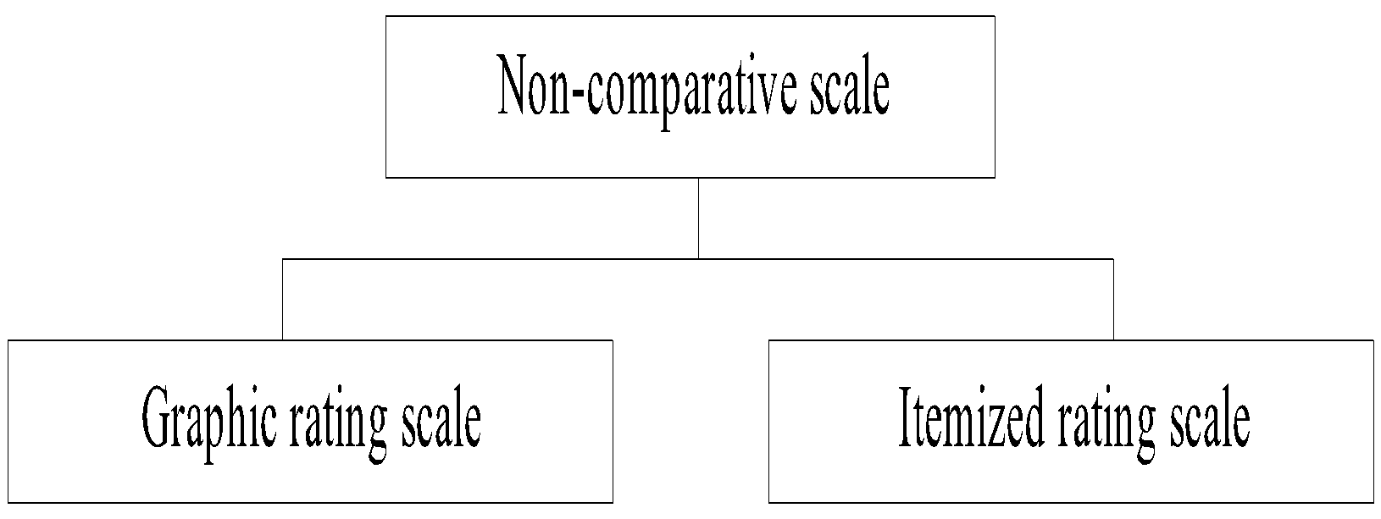
Classification of Scales
Non-Comparative Scales – In the non-comparative scales, the respondents do not make use of any frame of reference before answering the questions.

Slide 21

Graphic Rating Scale – This is a continuous scale and the respondent is asked to tick his preference on a graph.
Examples:

Slide 22

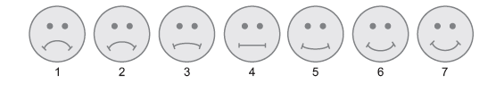
Please put a tick mark (•) on the following line to indicate your preference for fast food.
Alternative Presentation of Graphic Rating Scale –
Please indicate how much do you like fast food by pointing to the face that best shows your attitude and taste. If you do not prefer it at all, you would point to face one. In case you prefer it the most, you would point to face seven.

Slide 23
Itemized rating scale – In the itemized rating scale, the respondents are provided with a scale that has a number of brief descriptions associated with each of the response categories. There are certain issues that should be kept in mind while designing the itemized rating scale.
Number of categories to be used
Odd or even number of categories
Balanced versus unbalanced scales
Nature and degree of verbal description
Forced versus non-forced scales
Physical form

Slide 24
Examples of Itemized Rating Scales
Likert scale
The respondents are given a certain number of items (statements) on which they are asked to express their degree of agreement/disagreement.
This is also called a summated scale because the scores on individual items can be added together to produce a total score for the respondent.
An assumption of the Likert scale is that each of the items (statements) measures some aspect of a single common factor, otherwise the scores on the items cannot legitimately be summed up.
In a typical research study, there are generally 25 to 30 items on a Likert scale.

Slide 25
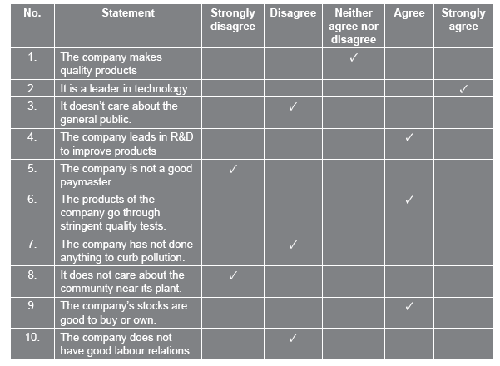
Example of a Likert Scale:

Slide 26
Semantic Differential Scale
This scale is widely used to compare the images of competing brands, companies or services.
Here the respondent is required to rate each attitude or object on a number of five-or seven-point rating scales.
This scale is bounded at each end by bipolar adjectives or phrases.
The difference between Likert and Semantic differential scale is that in Likert scale, a number of statements (items) are presented to the respondents to express their degree of agreement/disagreement. However, in the semantic differential scale, bipolar adjectives or phrases are used.

Slide 27
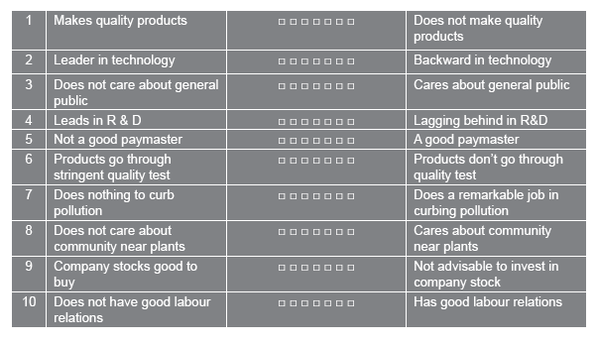
Example of Semantic Differential Scale:

Slide 28
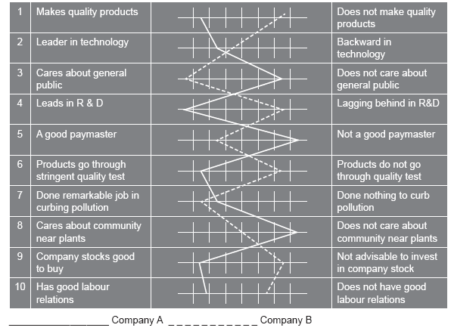
Classification of Scales
Example of Semantic Differential Scale: (Pictorial Profile)

Slide 29
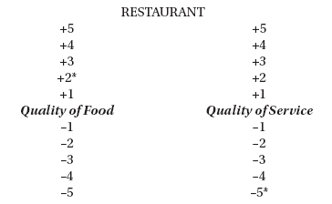
Stapel Scale

Slide 30
Measurement Error
This occurs when the observed measurement on a construct or concept deviates from its true values.
Reasons
Mood, fatigue and health of the respondent
Variations in the environment in which measurements are taken
A respondent may not understand the question being asked and the interviewer may have to rephrase the same. While rephrasing the question the interviewer’s bias may get into the responses.
Some of the questions in the questionnaire may be ambiguous errors may be committed at the time of coding, entering of data from questionnaire to the spreadsheet

Slide 31
Questionnaire
A Study of Customer Satisfaction towards State Bank of India
A Study of Employee Morale of an Automobile Company

Slide 32
Thank You

